Slide 1

Amazon Canada Picture Quality & Reviews
Gold 4 Anna Tarasiuk

Slide 2


Team
Anna Tarasiuk Bella Tarasiuk

Slide 3
Agenda
Business problem & Solution
Dataset & Visualization
Findings
Future releases

Slide 4
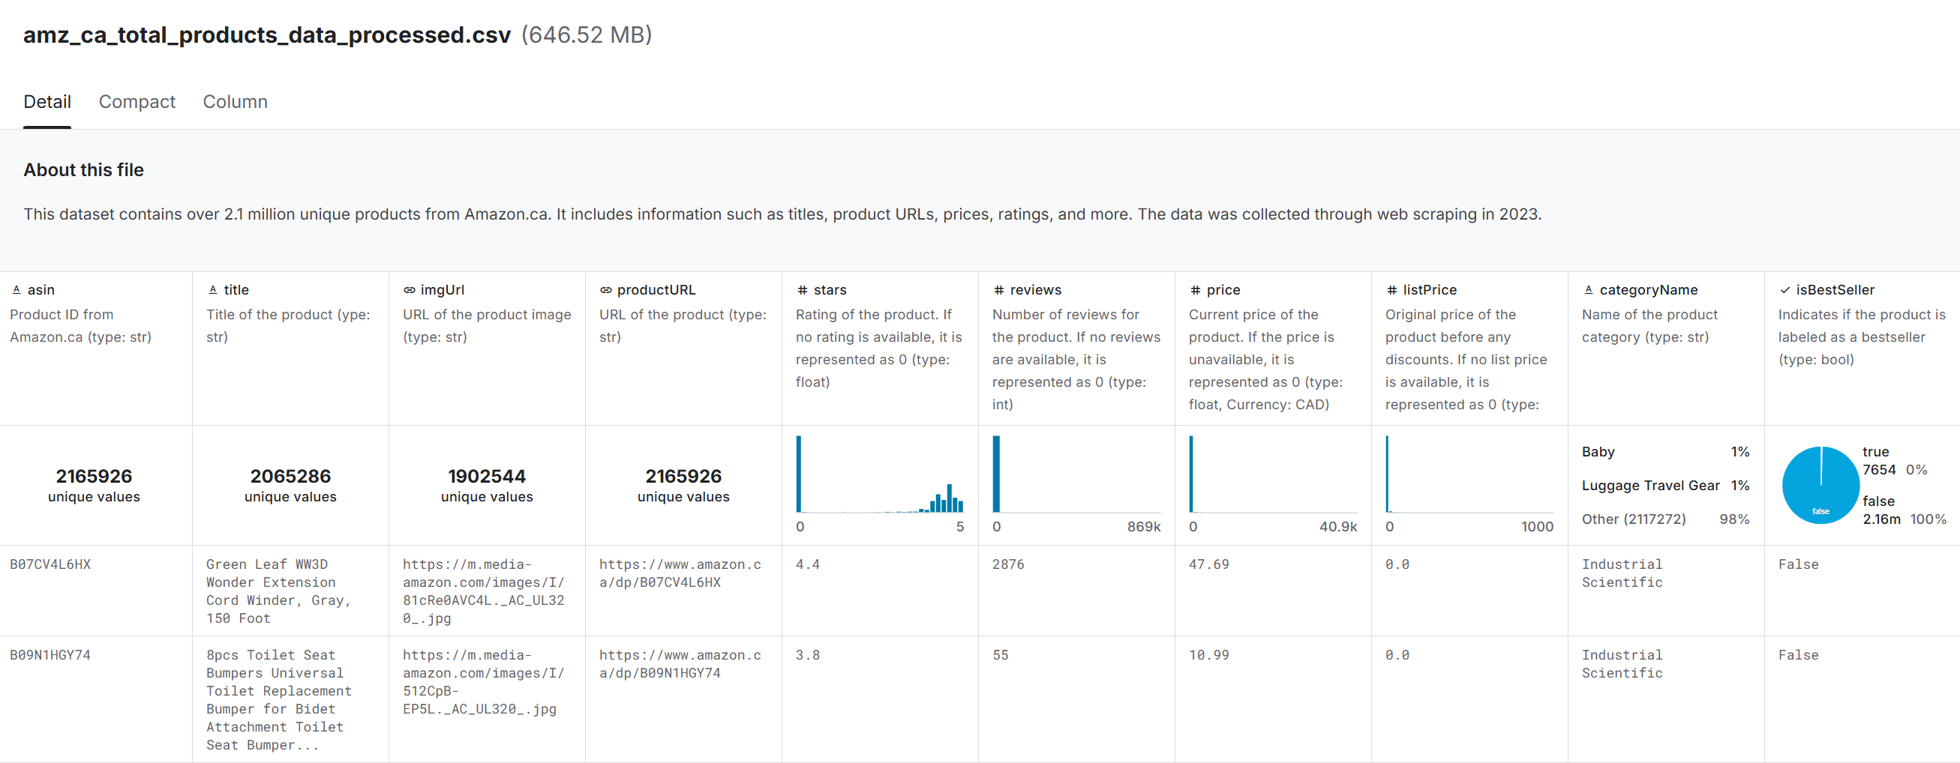
Dataset used – Kaggle Amazon.ca Total Products

Slide 5
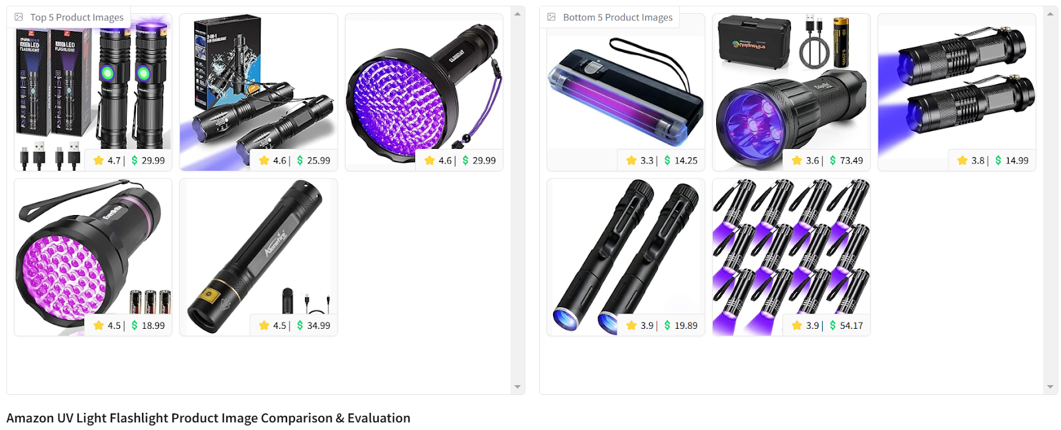
Business Problem
Selling on Amazon is extremely competitive. How can we leverage AI&ML to pick best quality photo for a given product relative to its category?

Slide 6
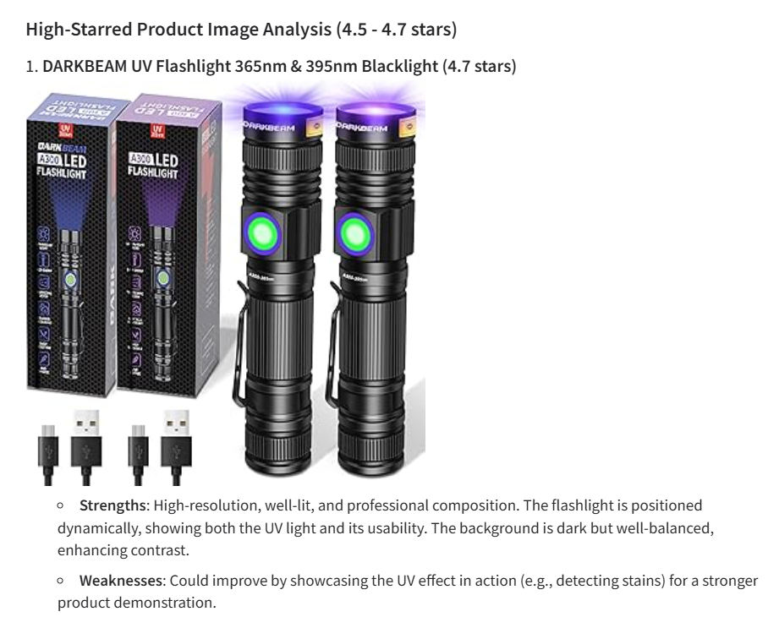
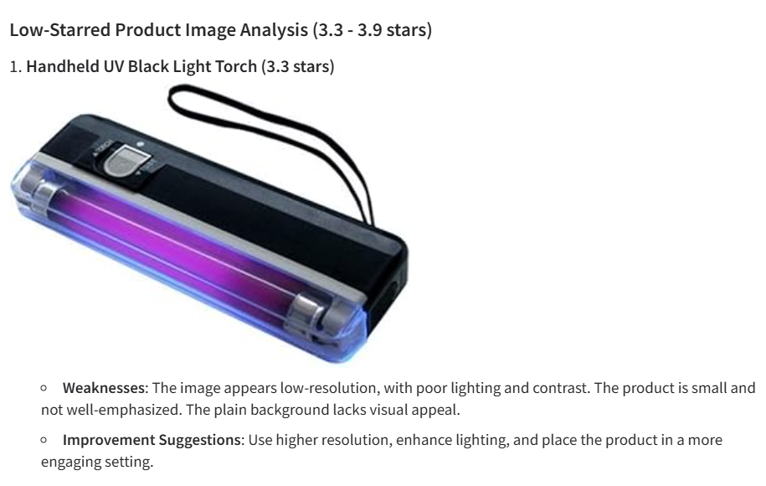
Steps
Parsed over 2.1 million Canadian Amazon product entries.
Grouped, classified, filtered into categories.
Leveraged OpenAI’s multi-modal LLMs to assess best and worst performing ASINs based on their images.
Gathered suggestions on proper actions to achieve best appeal and results.

Slide 7
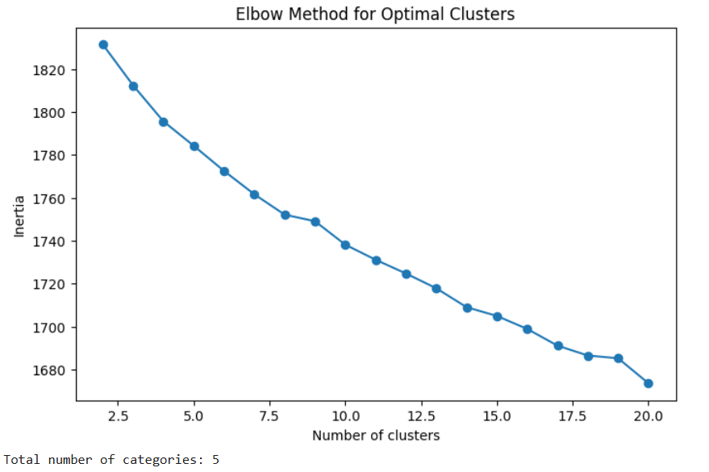
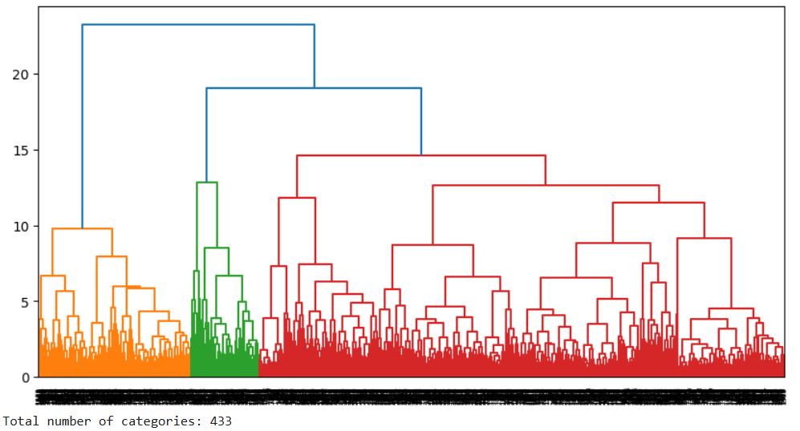
Clustering
Manually adjusting the number of K-means clusters was experimented with, achieving good clusters for the 9562 products in the range of 5-30. To automate and optimize cluster selection, the Elbow Method was attempted but yielded worse results than using the Silhouette Score.

Slide 8
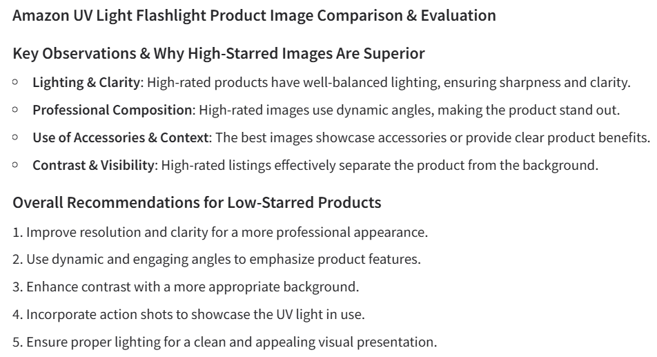
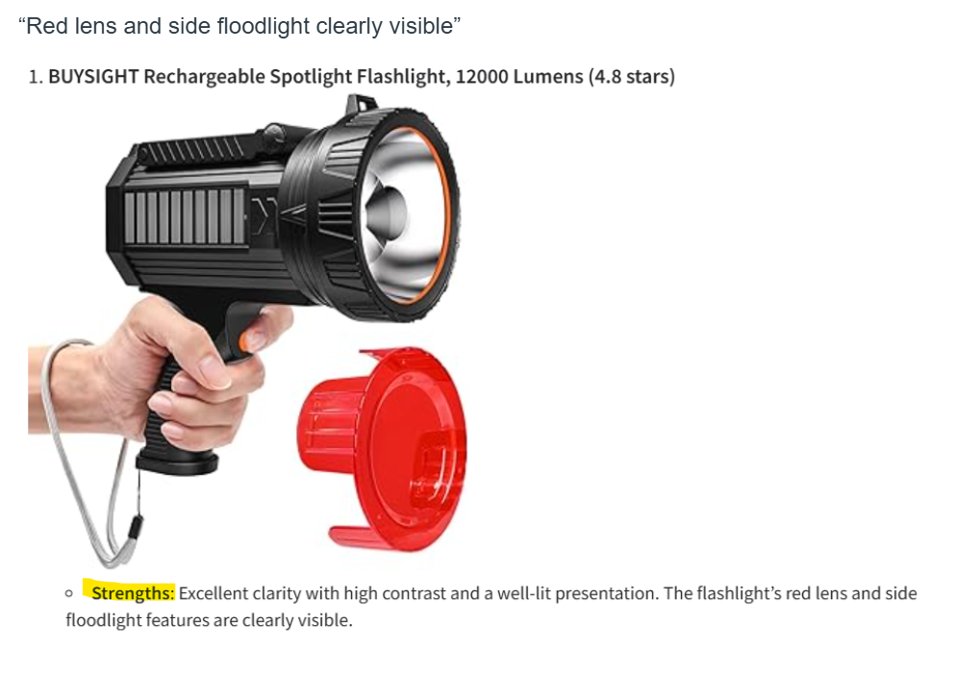
AI Recommendations
Amazon UV Light Flashlight
Uv-Light-Flashlight-Urine-Pet-Dry Stains-Uv Protective Glasses-Carpet

Slide 9
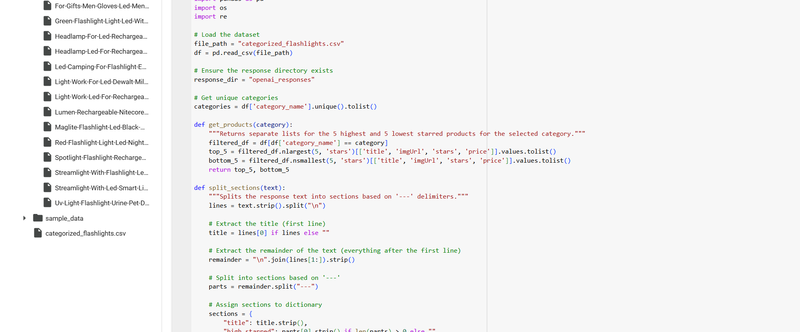
Demo

Slide 10

Thank you

